Slide 1
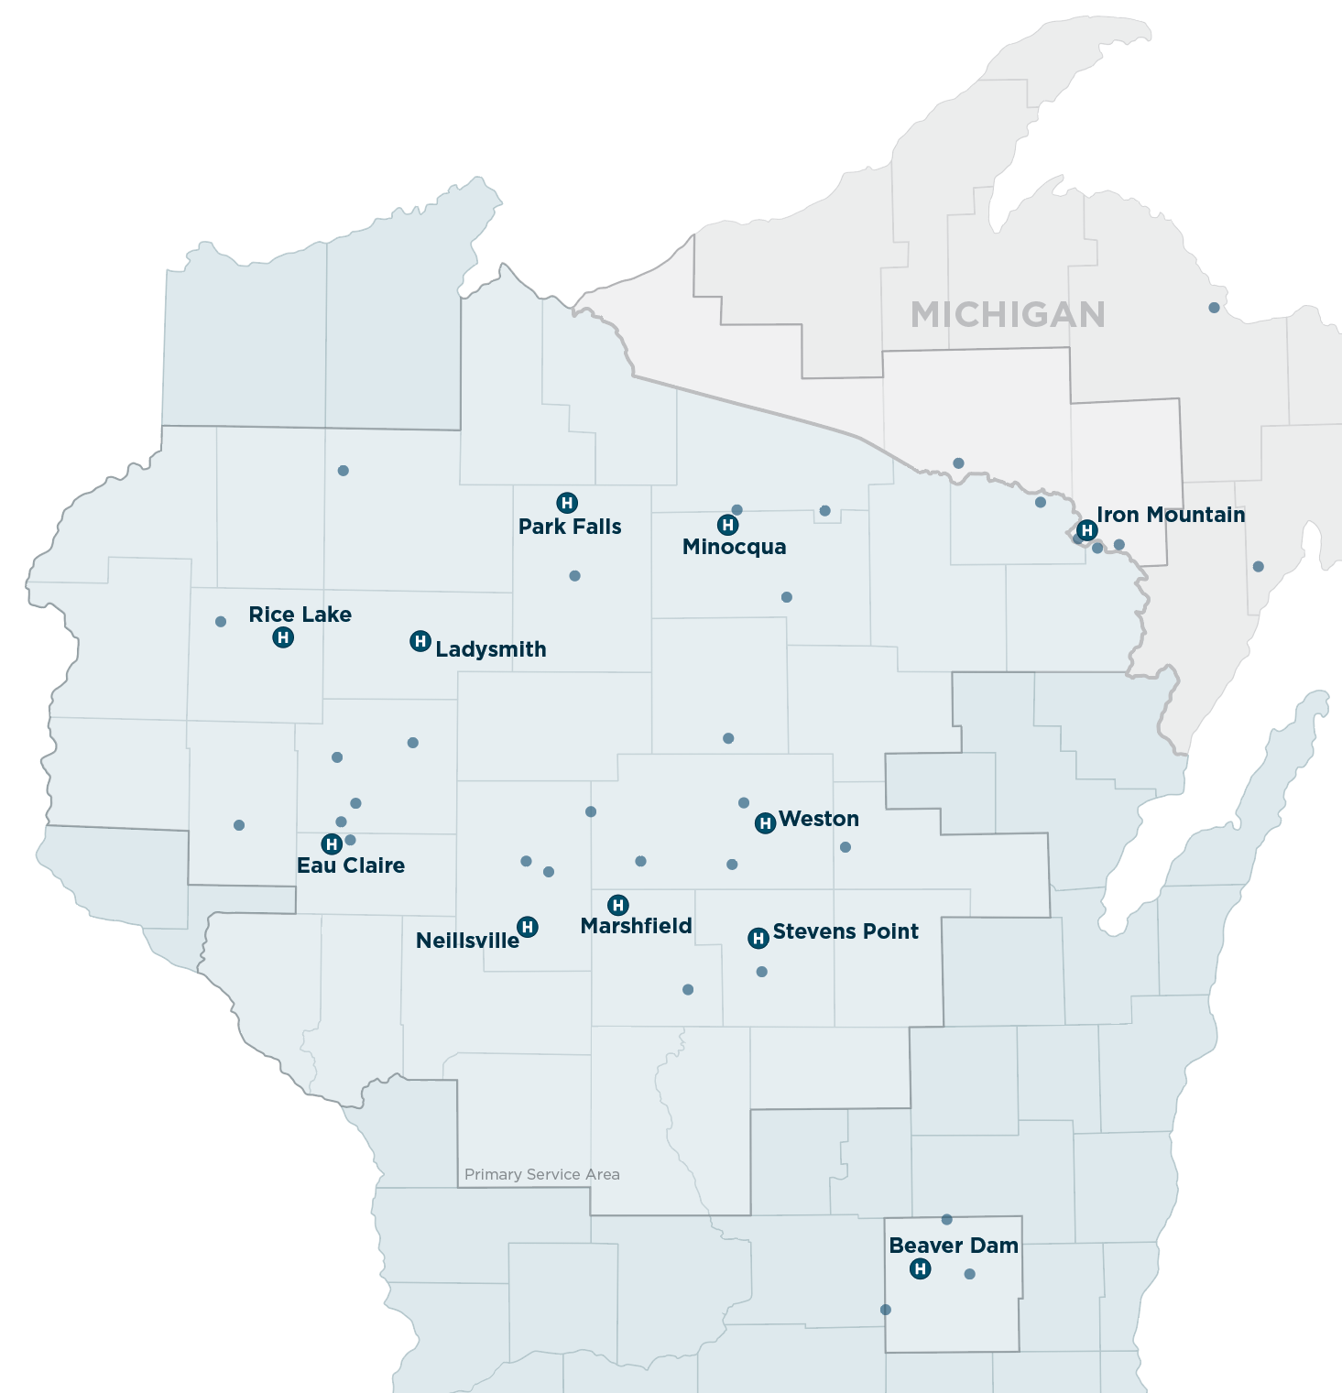

STRATEGIC AREAS OF FOCUS
2024-27
As an anchor institution in the communities we are honored to serve, Marshfield Clinic Health System believes that we have a moral and corporate responsibility and obligation to address the health and social needs of historically marginalized and under-resourced communities.
Our mission is: We Enrich Lives ... to create healthy communities.
We live our mission through collective impact, collaborative partnerships, and innovation to address policy, system and environmental health disparities that advance health equity, especially in rural communities.
The Strategic Areas of Focus represent complex
challenges that our patients, employees, and
communities experience every day that we
are committed to improving.
Behavioral Health
Rural communities face many challenges to behavioral health including access, availability, affordability, and acceptability.
Community Capacity, Engagement and Infrastructure
Rural communities face serious social, economic and health challenges.
Health Equity
Health inequities in rural communities are numerous and vary by region including transportation, food insecurity, and many other health related social needs.
Substance Use
Substance use can be especially hard to combat in rural communities due to limited resources for prevention, treatment and recovery.
Community Impact and Social Accountability (CISA)

